Slide 1
JSON Transcript Technologies
Michael D. Morris

Slide 2
Approach to Technologies
Guiding principle:
“There are no solutions, only trade-offs”

Slide 3
Technologies for JSON Transcript
JSON
JSON-LD
JSON Schema
XML Schema to JSON Schema
Open API (aka Swagger)
EdExchange

Slide 4
JavaScript Object Notation (JSON)
A subset of JavaScript Programming Language (no functions)
Light weight text-based data exchange format
Uses C string conventions (e.g., \ as escape character)
The JSON syntax can be used to develop semantically rich applications (e.g., JSON Schema, JSON-LD) by adding meaning to object properties.

Slide 5
JSON (continued)
Used by most RESTful web services (APIs) for both request and response data
Used in web applications for data exchange using JavaScript (e.g., AJAX)
Can be marshaled (to string) and unmarshaled (to native data structure) directly with JavaScript and Node.js
All major programming languages provide JSON marshaling and unmarshaling tools.
JSON Schema standard is supported by third party tools (e.g., XML Spy, Oxygen, JetBrain IDEs, Visual Studio Code)

Slide 6
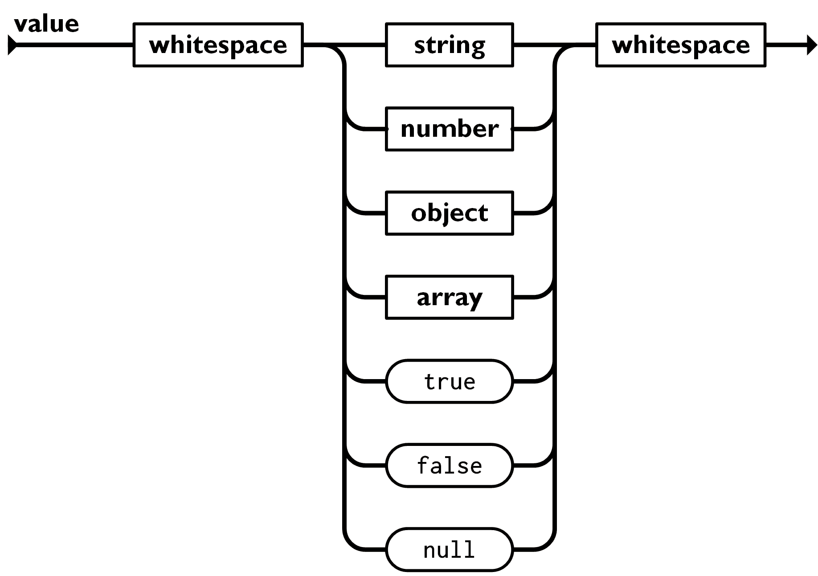
JSON Values
"Michael"
6.022E23
666
64.6
{"name": "Michael",
"location": "Iowa City"}
[1, 5, 9]
["a", "b, "c"]
[{"name": "Michael"},3, false]
true
false
null
Note: All the syntax diagrams in this presentation were borrowed from www.json.org

Slide 7
JSON Advantages over XML
Easier to read by humans
Easier to manipulate with most programming languages
Smaller payloads and less bandwidth required for tranmission
Easier to learn and understand
Evidence: JSON has replaced XML in many applications (configuration files, web services, data exchanges, AJAX, etc.).

Slide 8
"Course" : [ {
"CourseCreditUnits" : "Semester",
"CourseCreditBasis" : "Regular",
"CourseCreditLevel" : "LowerDivision",
"CourseCreditValue" : 5.0,
"CourseCreditEarned" : 5.0,
"CourseAcademicGradeScaleCode" : "25",
"CourseAcademicGrade" : "A",
"CourseCIPCode" : "27.0102",
"CourseQualityPointsEarned" : 20.0,
"CourseLevel" : "LowerDivision",
"CourseGPAApplicabilityCode" : "Applicable",
"CourseSubjectAbbreviation" : "MATH",
"CourseNumber" : "100",
"CourseTitle" : "Elementary Algebra"
}, …]

Slide 9
XML Advantages
XML provides a comprehensive namespace construct. This is not part of basic JSON.
XML Schema provides more complex and sophisticated data modeling constructs (e.g., attributes, elements, extensions, restrictions, substitution groups).
XML Schema provides an extensive set of data types.
XML Schema sequence allows ordering of tags. JSON cannot set the order of object properties.

Slide 10
Example XML
<Course>
<CourseCreditBasis>Regular</CourseCreditBasis> <CourseCreditUnits>Semester</CourseCreditUnits> <CourseCreditLevel>Graduate</CourseCreditLevel> <CourseCreditValue>3</CourseCreditValue> <CourseCreditEarned>3</CourseCreditEarned> <CourseAcademicGradeScaleCode>25</CourseAcademicGradeScaleCode <CourseAcademicGrade>A</CourseAcademicGrade>
<CourseCIPCode>999</CourseCIPCode> <CourseSubjectAbbreviation>PHL</CourseSubjectAbbreviation> <CourseNumber>388</CourseNumber>
<CourseTitle>CONFERENCE COURSE</CourseTitle>
</Course>

Slide 11
JSON-LD (Linked Data)
http://www.w3.org/2006/vcard/ns#Address
"name": "http://xmlns.com/foaf/0.1/name
"name": "http://xmlns.com/foaf/0.1/name
An application using JSON syntax; that is, certain property names have meaning (@context, @id, @graph, @type)
Instead of namespaces, JSON-LD names are individualized by IRIs:
International Resource Identifier uses Universal Coded Character Set (UCC)
Uniform Resource Identifier are a subset of IRIs using ASCII encoding
Example: @context {"name": "http://xmlns.com/foaf/0.1/name}

Slide 12
JSON-LD keywords
@context is used to define the terms used in a JSON-LD document:
@id is used to specify a node in a graph that can be referenced by other nodes
@type is used to define constraints on the value of the property value
@graph uses Resource Description Framework (RDF) to form relationships between objects (linking)
There are other key words, but these are the most common.

Slide 13
Example Context
{"@context":
{
"email":
{
"@id": "http://xmlns.com/foaf/0.1/mbox",
"@type": "@id"
},
"name": "http://xmlns.com/foaf/0.1/name",
"gender": http://schema.org/gender
}
}

Slide 14
Example JSON-LD
{
"@context": "https://json-ld.org/contexts/person.jsonld",
"@id": "http://act.org/employees/morrism",
"name": "Michael Morris",
"gender": "male",
"email": "mailto:michael.morris@act.org"
}

Slide 15
Preview of JSON Schema
JSON Schema specifies and validates that:
The property values are the appropriate types: Numbers are numbers, dates are dates, and SCED codes are SCED codes.
A property is required in the document
A required property's value can be null
A property is present conditionally depending on another property value
A property's value is in a list of acceptable values (enumerations)
That a value is the correct format (standard format or regular expression)
Can be used in conjunction with JSON-LD

Slide 16
Schema Example
{
"$schema": "http://json-schema.org/draft-04/schema#",
"description": "JSON Schema for PESC College Transcript",
"type": "object",
"additionalProperties": false,
"required": [
"Student",
"TransmissionData"
],
"properties": {
"NoteMessage": {
"items": {
"$ref": "#/definitions/NoteMessageType"
},
"type": "array"
},
"Student": {
"$ref": "#/definitions/StudentType"
},
"TransmissionData": {
"$ref": "#/definitions/TransmissionDataType"
},
"UserDefinedExtensions": {
"$ref": "#/definitions/UserDefinedExtensionsType"
}
},
"definitions": {…}
}

Slide 17
JSON Schema Snippet
{
"AgencyCodeType": {
"description": "A code that describes the type of agency that assigned the student's identification number",
"enum": [
"District",
"Migrant",
"MutuallyDefined",
"National",
"Province",
"Regional",
"State"
],
"type": "string"
},
"AgencyCourseIDType": {
"description": "The course ID that might have been assigned to this course by the state or other agency",
"maxLength": 30,
"minLength": 1,
"type": "string"
}
}

Slide 18
Open API
Specifies RESTful web services in JSON or YAML
Uses HTTP methods (GET, POST, PUT, DELETE) to determine the type of action taken by the web service
Uses traditional request-response actions of HTTP
Uses JSON Schema to specify request payloads

Slide 19
XML Schema to JSON Schema
Current Solution:
Create subset schema with XSLT
Create JSON Schema using XML Spy
Future Solution:
Python program that takes XML Schema and produces JSON Schema
Because the program does not require other off-the-shelf technologies, JSON-LD constructs (@context, @id, @types) can be added

Slide 20
EdExchange
EdExchange uses the transcript XML schema to generate a parser that can parse and validate JSON or XML
If JSON is needed for transmission EdExchange can produce JSON even if the original transcript was XML.

